Slide 1


Slide 2
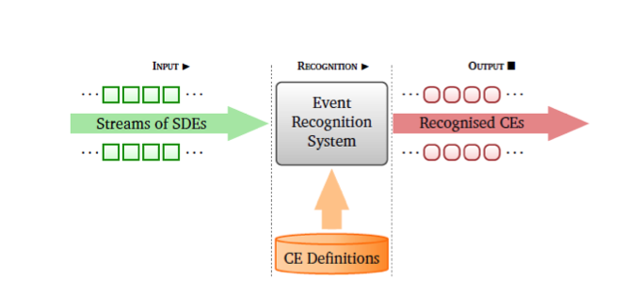
Complex Event Detection – The Big Picture
Input: Streams of Simple Derived Events (SDEs)
Output: Complex Events (CEs)
    Collections of SDEs/CEs satisfying some pattern
    Patterns defined using a variety of contraints (temporal, spatial, logical,…)
    N. Giatrakos, E. Alevizos, A. Artikis, A. Deligiannakis, M. Garofalakis: Complex event recognition in the Big Data era: a survey. VLDB J. 29(1): 313-352 (2020)

Slide 3
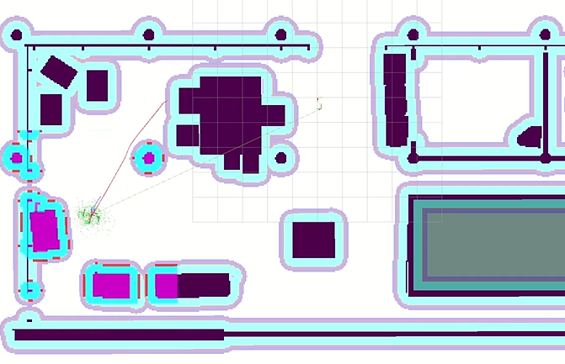
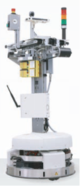
Motivating Example: Safe Robot Navigation in Smart Factory Scenarios
SDE Instances:
    Stopped
    Moving
    At Station Si (@Si)
    Rotating
    Goal: Reached Delivery Target
    Blocked: Wall/obstacle
    …
Pattern: SEQ(@Si, Moving, Rotating, Stopped, Blocked, Rotating)
within 5mins
CE: Delivery Failure
Aftermath: Delays in production line L
Credits: DFKI

Slide 4
Raw Streams: Actual Input
Raw streams are not SDEs in the real world ☹
current_time | current_step | pos_x | pos_y | pos_z | rot_x | rot_y | … | rot_z | …
8.35 | 752 | -3.626 | 14.921 | 0.258 | 0.0987 | -0.0019 | … | 0.9951 | …
8.36 | 753 | -3.631 | 14.922 | 0.258 | 0.0979 | -0.0019 | … | 0.9951 | …
30.57 | 3382 | -7.473 | 23.746 | 0.258 | 0.8197 | -0.0012 | … | 0.5727 | …
38.31 | 3448 | -4.432 | 23.861 | 0.258 | 0.8235 | -0.0011 | … | 0.5671 | …
41.15 | 3704 | -7.446 | 23.866 | 0.257 | 0.9951 | 0.0006 | … | 0.0977 | …
41.12 | 3705 | -7.444 | 23.867 | 0.258 | 0.9952 | -0.0001 | … | 0.0972 | …

Slide 5
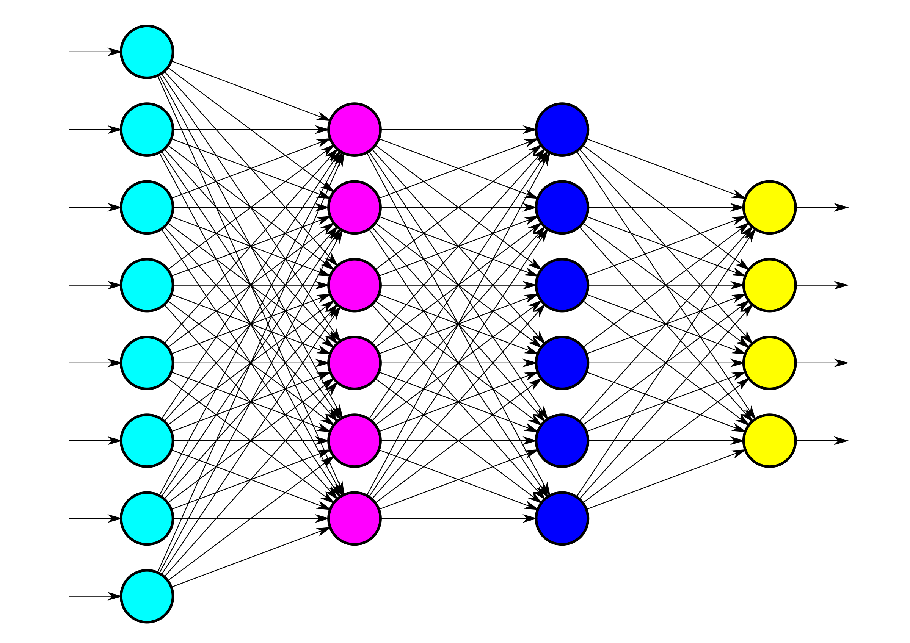
Desiderata for SDE Extraction: Part I
Ground Truth - Labeled tuples → Simulations
Examples of actual SDEs
…used to train (NN) models
…used to tag unlabeled tuples from the application field
current_time | current_step | pos_x | pos_y | pos_z | rot_x | rot_y | rot_z | … | Label/SDE
8.35 | 752 | -3.626 | 14.921 | 0.258 | 0.0987 | -0.0019 | 0.0001 | … | stopped
8.36 | 753 | -3.631 | 14.922 | 0.258 | 0.0979 | -0.0019 | 0.0001 | … | stopped
30.57 | 3382 | -7.473 | 23.746 | 0.258 | 0.8197 | -0.0012 | 0.0015 | … | moving to Station2
38.31 | 3448 | -4.432 | 23.861 | 0.258 | 0.8235 | -0.0011 | 0.0013 | … | @ Station2
41.15 | 3704 | -7.446 | 23.866 | 0.257 | 0.9951 | 0.0006 | 0.0042 | …. | @ Station2
41.12 | 3705 | -7.444 | 23.867 | 0.258 | 0.9952 | -0.0001 | 0.0032 | …. | moving to Station3

Slide 6
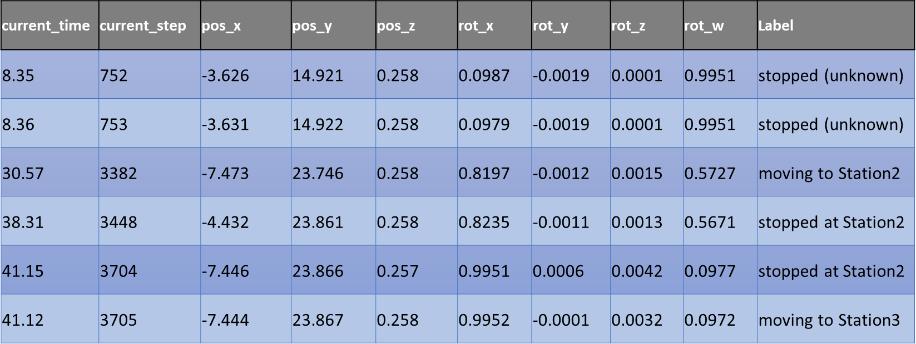


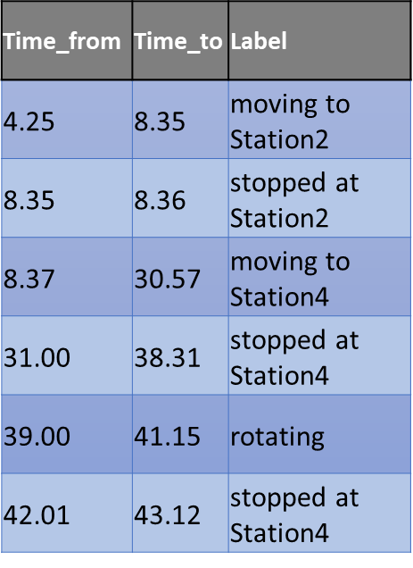
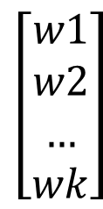
SSTRESED Version 1.0
$$\left[\begin{aligned}w1 \\ w2 \\ … \\ wk\end{aligned}\right]$$
Labeled Time Series - Simulations
NN Weight Updates
Training Topic
Weights Topic
Learner
Movement Streams
Tagger/Classifier
SDEs
Unlabeled Time Series - Application Field
Training Pipeline
SDE Detection Pipeline

Slide 7
Desiderata for SDE Extraction: Part II
Support large scale applications – Big Data
  1000s of robots producing 100s of MB/min
  Rapid Continuous Model Training and Online SDE Detection
    High throughput : number of tuples being processed/tagged per time unit
    Low latency: amount of time a tuple remains in the Training/SDE detection pipeline
Solution: Scale-out all kinds of computation
  Multiple workers for the Training Pipeline
  Multiple workers for the SDE Detection Pipeline
  Parallel Processing: Key-based parallelization (Robot ID)

Slide 8
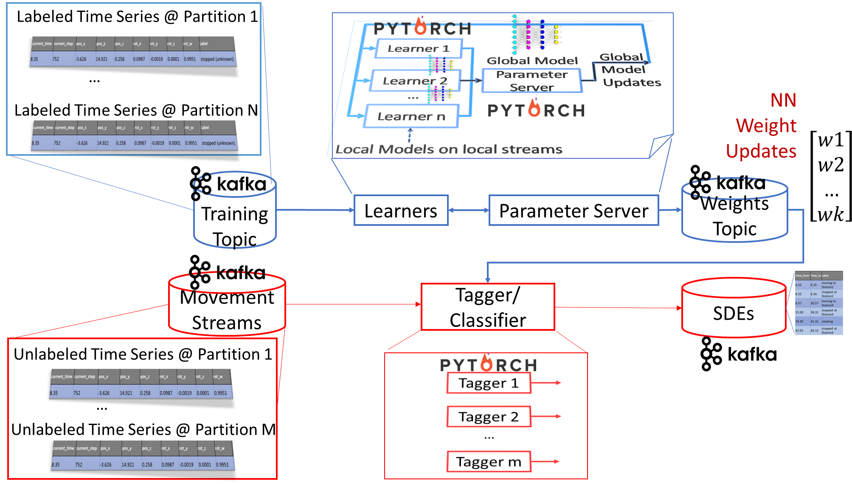
SSTRESED Version 2.0

Slide 9
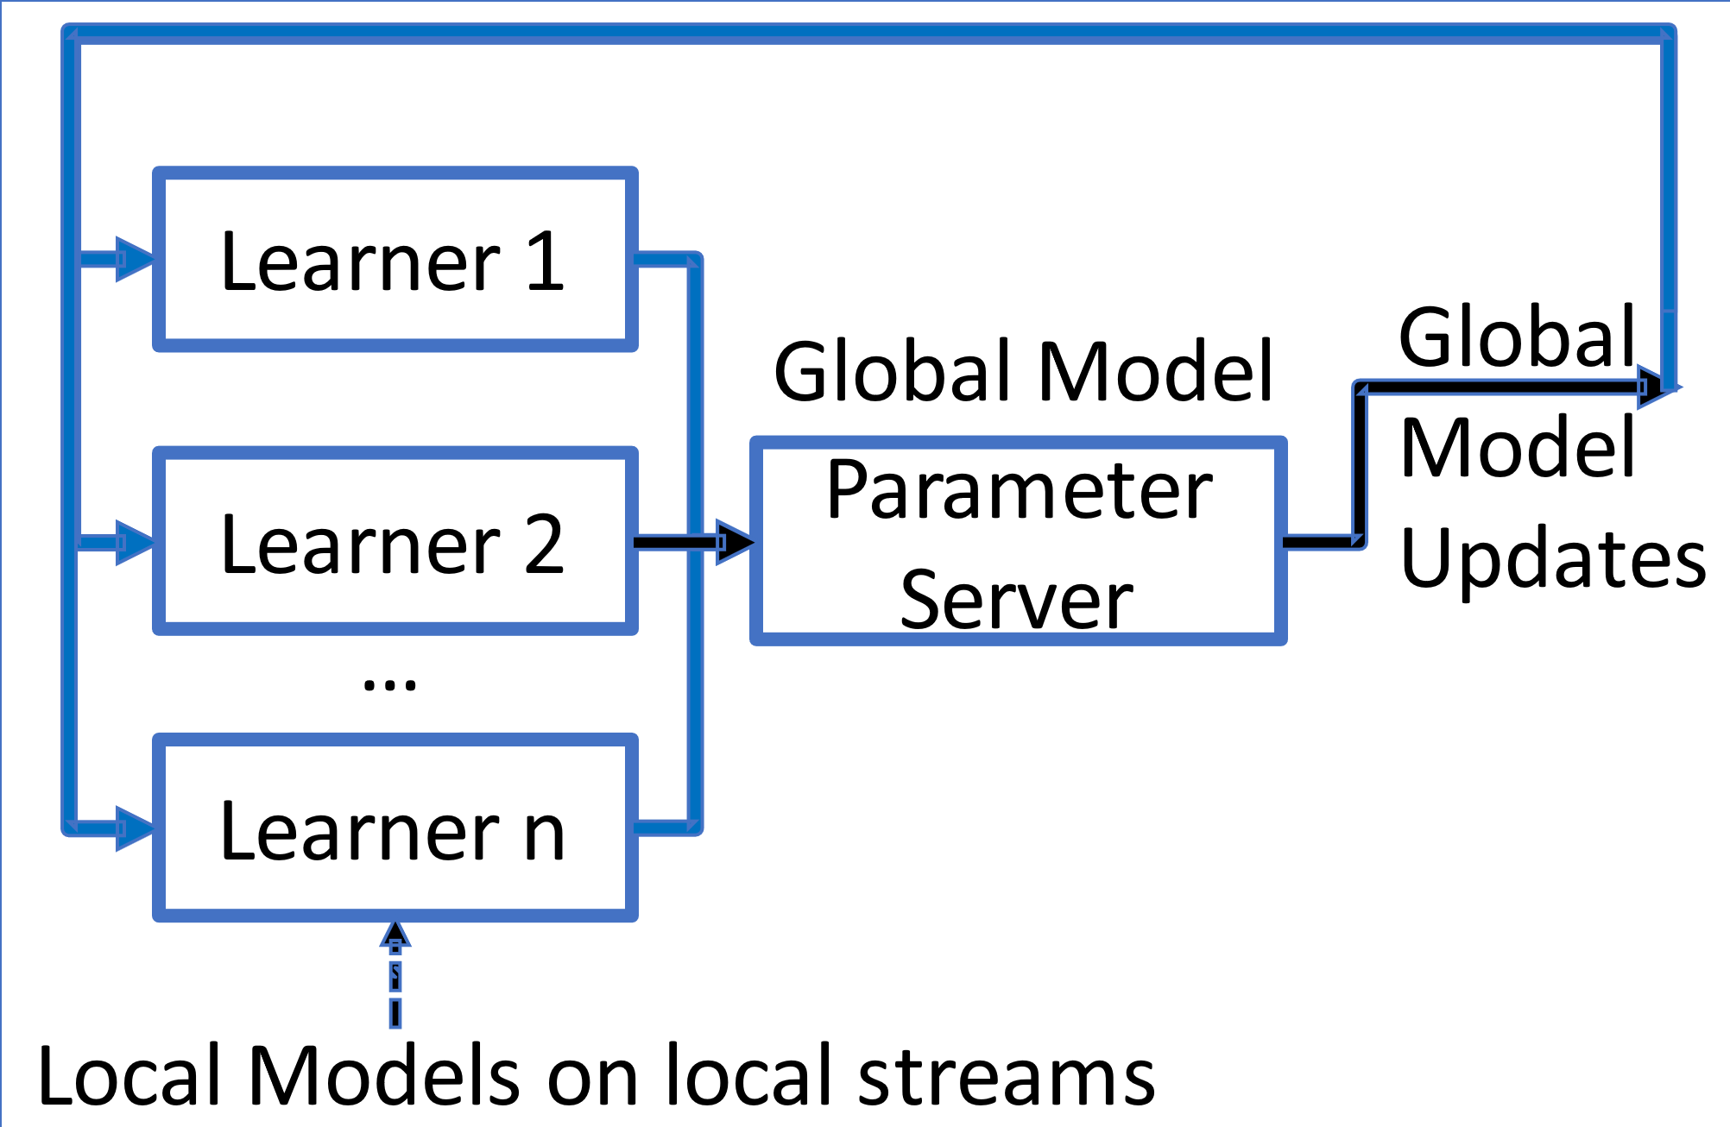





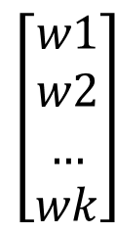
Labeled Time Series @ Partition 1
…
NN Weight Updates
Labeled Time Series @ Partition N
$$\left[\begin{aligned}w1 \\ w2 \\ … \\ wk\end{aligned}\right]$$
Training Topic
Weights Topic
Learners
Parameter Server
Movement Streams
SDEs
Tagger/
Classifier
Unlabeled Time Series @ Partition 1
Tagger 1
…
Tagger 2
Unlabeled Time Series @ Partition M
…
Tagger m
Notes:
The trajectory segmentor should deal with the variable input length issue.

Slide 10
Desiderata for SDE Extraction: Part III
SDEs (not only CEs) are implicitly durative in the Training Pipeline…
current_time | current_step | pos_x | pos_y | pos_z | rot_x | rot_y | … | rot_z | Label
8.35 | 752 | -3.626 | 14.921 | 0.258 | 0.0987 | -0.0019 | … | 0.9951 | stopped
8.36 | 753 | -3.631 | 14.922 | 0.258 | 0.0979 | -0.0019 | … | 0.9951 | stopped
10.01 | 888 | … | … | … | … | … | … | … | moving to Station2
30.57 | 3382 | -7.473 | 23.746 | 0.258 | 0.8197 | -0.0012 | … | 0.5727 | moving to Station2
35.88 | 3400 | … | … | … | … | … | … | … | moving to Station2
38.31 | 3448 | -4.432 | 23.861 | 0.258 | 0.8235 | -0.0011 | … | 0.5671 | @ Station2
41.15 | 3704 | -7.446 | 23.866 | 0.257 | 0.9951 | 0.0006 | … | 0.0977 | @ Station2
41.12 | 3705 | -7.444 | 23.867 | 0.258 | 0.9952 | -0.0001 | … | 0.0972 | moving to Station3

Slide 11
Desiderata for SDE Extraction: Part III
Required Output of the SDE Detection Pipeline…
Time_From | Time_To | SDE
8.35 | 8.36 | stopped
10.01 | 35.88 | moving to Station2
38.31 | 41.15 | @ Station2
41.12 | 45.85 | moving to Station3
… | … | …

Slide 12
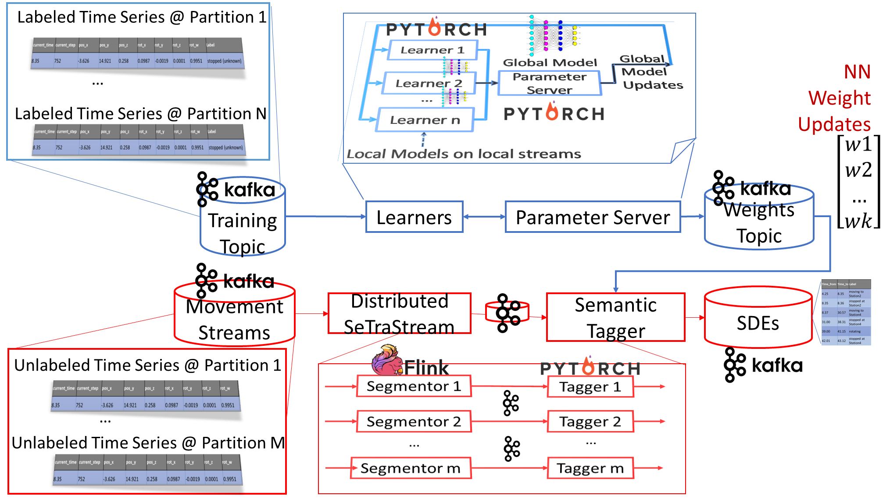
SSTRESED Version 3.0

Slide 13
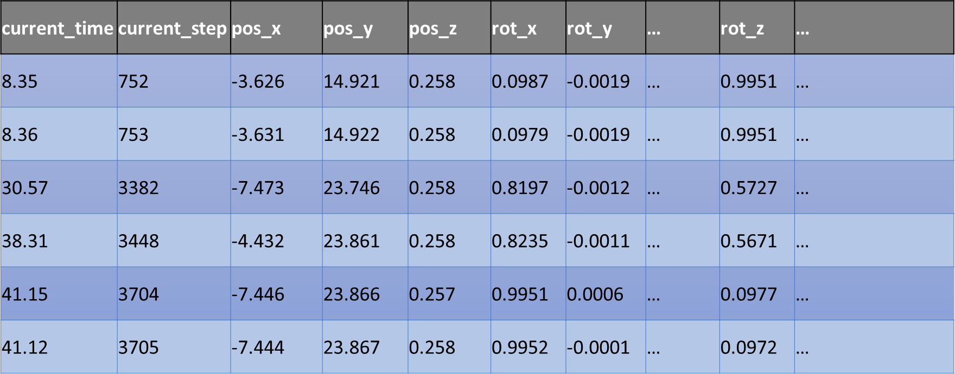
Movement Feature Vectors (MFVs) Micro-batches
Raw/Original MFVs
Derived MFVs
MFVs in micro-batch make up a Matrix
35 | … | 60
76 | … | 85
40 | … | 55
0.1 | … | 0.05
1 | … | 3
π/36 | … | π/16
speed | direction | acceleration
35 m/s | 76º | 40 m/s²
… | … | …
60 m/s | 85º | 55 m/s²

Slide 14
Distributed SeTraStream –Segmentor View
Robot O₁
Incoming micro-batches per Robot ID
…
Candidate Div Point
O_{i}
O₅
…
Robot O_{i}
W_{1l}
W_{r}
Long term change?
O₈
SDE₁
SDE₂
Short term change?
W_{2l}
W_{3l}
…
Robot O_{F}

Slide 15
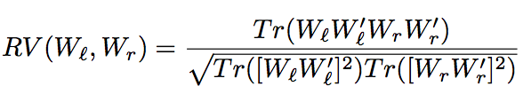
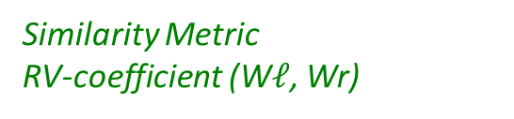
Distributed SeTraStream – Segmentation Rationale
T
Robot O₁
Incoming micro-batches per Robot ID
…
Candidate Div Point
O₅
…
O₈
Robot O_{i}
O_{i}
W_{1l}
W_{r}
SDE₁
SDE₂
Dissimilar features?
If YES
σ thres
…
Robot O_{F}
Similarity Metric
RV-coefficient (W$ℓ$, Wr)

Slide 16

Distributed SeTraStream – Tagging SDEs
Robot O₁
…
Div Point
Robot O_{i}
SDE₁
SDE₂
SDE₃
End of SDE₃
Start of SDE₄
…
Robot O_{F}

Slide 17
Distributed SeTraStream –
Long-term Movement Change
T
Incoming micro-batches per Robot ID
Robot O₁
…
Candidate Div Point
O₅
…
O₈
Robot O_{i}
O_{i}
W_{1l}
W_{r}
SDE₁
SDE₂
dissimilar features?
W_{2l}
If NO
σ thres
W_{3l}
…
Robot O_{F}
Similarity Metric
RV-coefficient (W$ℓ$, Wr)

Slide 18

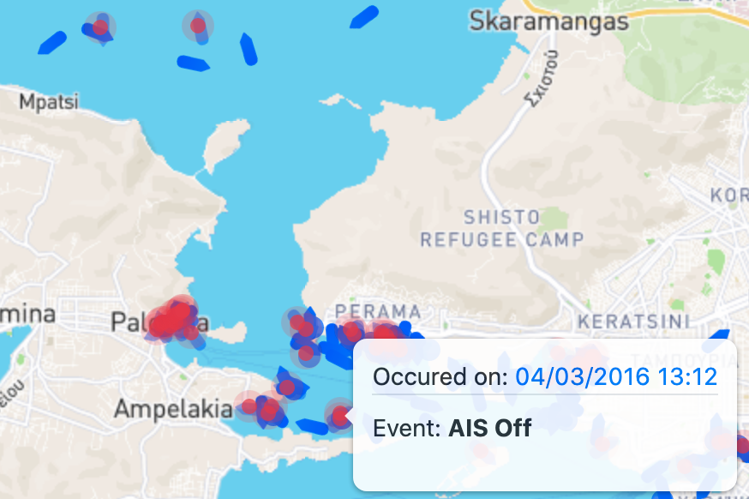

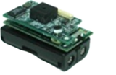
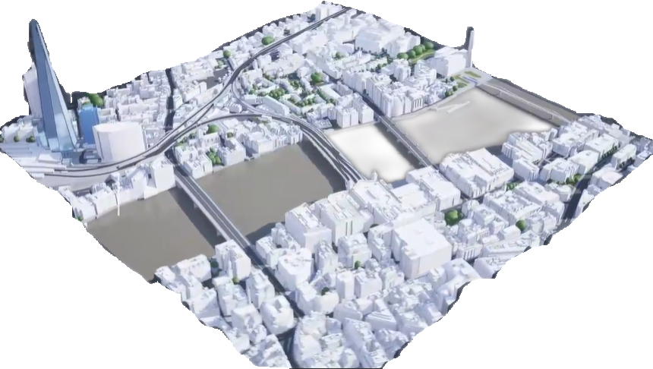



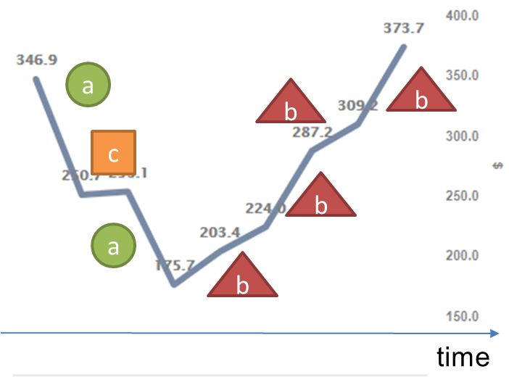
SSTRESSED Epilogue
1st Scalable Streaming Framework for SDE Detection
  Novel framework & architecture treats SDEs as first-class citizens
  Distributed processing across state-of-the-art Big Data Technologies
  1st to combine streaming semantic trajectory extraction and CER
More Applications
On-going work
  Complete implementation
  Enrich semantics (terrain images, map POIs etc)
  Trajectory compression before segmentation
  Wayeb[VLDBJ’22], EasyFlinkCEP [CIKM’21] Interoperability
Credits: MarineTraffic

Slide 19


Thank you
Nikos Giatrakos
ngiatrakos softnet.tuc.gr
ngiatrakos athenarc.gr

